Slide 1
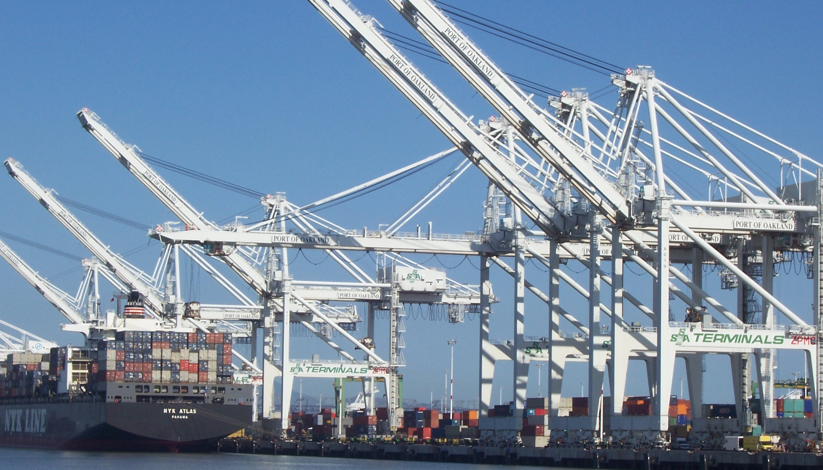



Pivotal Cloud Foundry
Architecture & Operations

Slide 2
The Whole Stack
Notes:
Now you have seen for your selves how easy it is to relive ITOPS from the burdon of managing so many apps! You know know first hand how to better utilize your developer talent to maximize innovation.
So what’s going on under the hood?
The elastic runtime is where apps are pushed, staged, deployed, and managed.
BOSH is used for the orchestration of the entire system.
High availability comes in several flavors too.
Now lets discover together how elegant of a solution PCF really is!
--
You should never give this presentation to folks who have not seen a basic CF demo. You want to use the push of an app, with a service binding (i.e. spring-music) as the backstory for this deck.
The story line for this deck is:
you’ve seen us deploy and scale and app; we want to show you how it’s done.
This deck is intended to instill confidence in our customers, that they can trust their application to our platform. Cloud foundry is implemented with well understood patterns for distributed, web-based computing that result in extreme scalability and resilience. We know cloud and distributed systems.
We have two main layers:
The part that runs your apps (the elastic runtime)
And a whole ‘nother, kickass system, BOSH, that manages the elastic runtime and services
Let’s see how the elastic runtime deploys your app, supports service bindings and scales your app.
Let’s then see how BOSH deploys clusters, such as the elastic runtime, and services.
BUT that’s not all! Now show that the platform does SO much more than just deploy apps or clusters. → The four levels of HA.
Point out similarity of patterns between the ERS and BOSH. These are some of the patterns for distributed systems. This instills confidence.

Slide 3

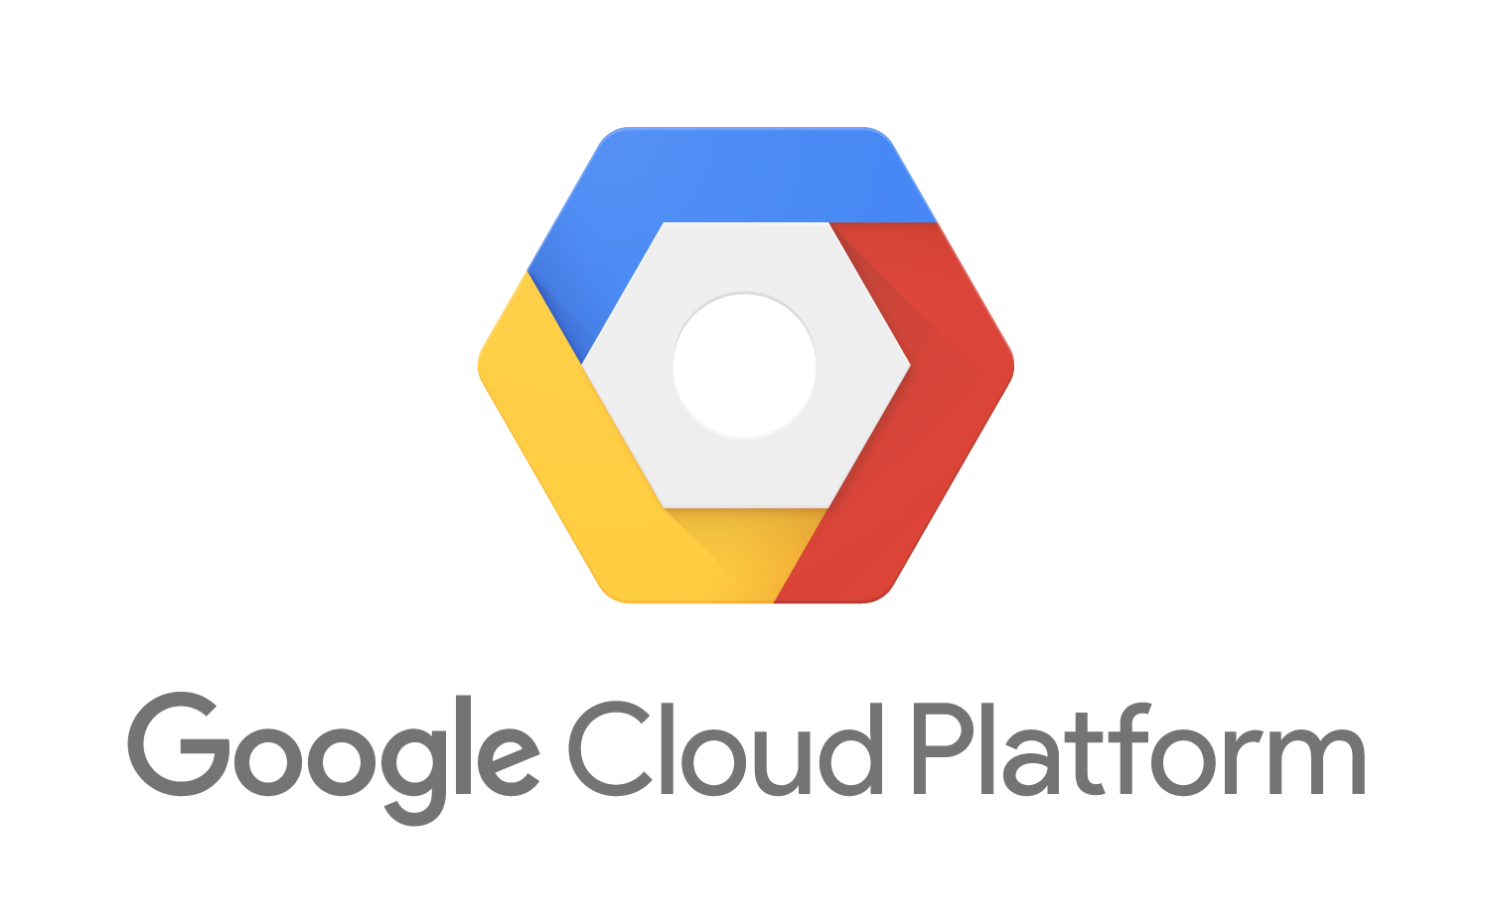




A Multi-Cloud Platform: Cloud Foundry
Elastic managed runtime service integrated into leading data services; all scaled and managed by CF BOSH
Jenkins Service
(CI)
Elastic
Container
Runtime
Agile Microservices
Redis
MySQL
Rabbit MQ
DataStax
Cassandra
Multi-Cloud Declarative Service Deployment, Operations
Cloud Foundry BOSH
Azure
Notes:
Here we have a birds eye view of PCF
-- Deployed over your favorite IaaS solution is our Elastic Runtime – a set of microservices that defines PCF
-- Several application services are integrated into the platform like Jenkins, Messaging, Caching, Hadoop, etc, the list is always growing!
-- The deployment is managed by OSS Cloud Foundry BOSH which we simplify via Ops Manager, a web based management interface
----
When I can, I like to whiteboard this picture – interactive.
Start with the elastic runtime
Managed by BOSH
IaaS agnostic
Other services/clusters managed by BOSH – KV Store, … and even partners, i.e. Jenkins.

Slide 4




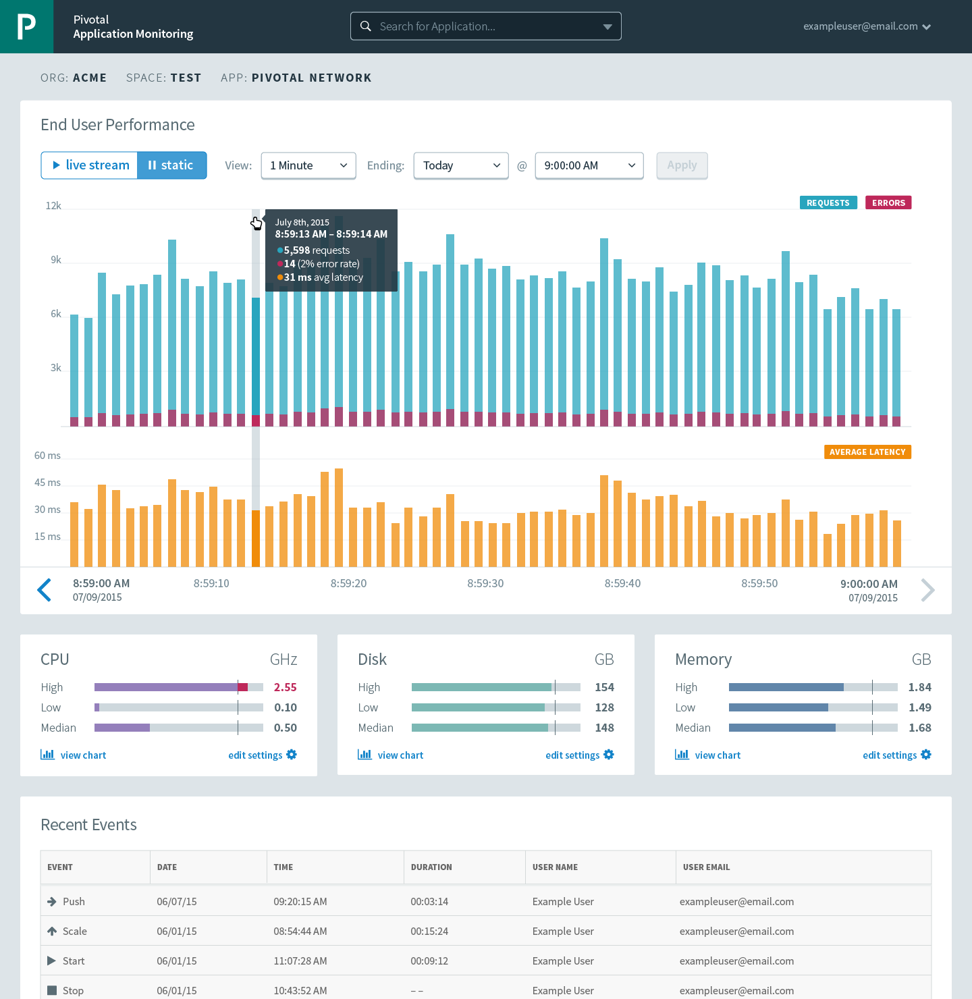





Cloud Foundry: An Application-centric Platform
Mobile Services
Centralized Log Management
Networking
& Load Balancing
Auto-Scaling
APM & Tracing
APPLICATION
Health management
Full Stack CI/CD platform
Notes:
So Spring Boot/Cloud meant create apps fast – But Dev & Ops is asking Day2 questions -
How do you do logging, routing, apm, scaling, and lifecycle management of all these apps.
Enter CF Runtime
best in class container management
integrated agentless logging
with APM
auto scaling
Effortless runtime with minimum human operational overhead. We run 1000s of apps and 10,000s containers on PWS with 6 guys.
But we realized that stopping there wasn't enough

Slide 5
Elastic Container Runtime
Technical Drill Down
Notes:
Now dive into the ERS
http://docs.pivotal.io/pivotalcf/concepts/architecture/

Slide 6


Pivotal Cloud Foundry
Login Server
OAuth 2.0 Server (UAA)
Platform Access
Ops Manager
Ops Manager UI
Elastic Container Runtime
Ops Manager Director
Cloud Controller
Blobstore
Brain
Operations Manager
CELL
CELL
Auctioneer
Service
Rep
Exec.
Rep
Exec.
Converger
Service Broker
Service Nodes
Garden
.NET
Dynamic Router
BBS
Service
Metron Agent
etcd
Service
Metron Agent
Service Broker
Loggregator
Container Access
Service Nodes
Logging / Metrics
Application
Access
Traffic Controller
Service
Doppler
Log Firehose
SSH Proxy
BOSH - Automation Layer
Azure

Slide 7


D e m o
Notes:
Push an App, show the logs

Slide 8


Overview: Pushing an Application
Blobstore
DB
Service
credentials
Upload app bits and metadata
Stage
Cloud Controller
Service Broker Node(s)
Deploy
push app
+ app MD
Cloud Controller Bridge
BBS / etcd
Create and bind services
Stage application
Deploy application
Manage application health
Router
CELL
Brain
DEA
DEA
Auctioneer
+
=
Task
LRP
Runtime
Notes:
Cloud Foundry PaaS
An application runs in a CELL, which is a droplet execution agent. The Cloud Controller orchestrates the routing and lifecycle of all DEAs in the pool. Routers manage application traffic. Health Manager reports mismatched application states to the CC. A service gateway provides an interface for services (native or external). A messaging bus manages all system communication. Apps are accessed directly through the router while web and CLI clients (e.g., vmc, STS) access Cloud Controller via RESTful services.

Slide 9
Creating and Binding a Service
Service
credentials
DB
CLI
create service (HTTP)
Cloud Controller
create service (HTTP)
Service
Broker
reserve resources
Data
Service
Router
bind service (HTTP)
bind service (HTTP)
obtain connection data
Runtime
http://docs.pivotal.io/pivotalcf/services/

Slide 10
Staging an Application
Staging Request
Task
Blobstore
Cloud Controller
Cloud Controller Bridge
BBS / etcd
Service
credentials
CELL Auction
Brain
DB
Auctioneer
Router
CELL
System
Buildpacks
Detect
Compile
Upload
No
Yes
Python
+
=
Java
Runtime

Slide 11
Staging and Buildpacks
Buildpacks are responsible for preparing the machine image for an application.
}
Application
Buildpack
Container
Libraries
Droplet
CELL
Runtime
Operating System

Slide 12
Buildpack Flavors
Buildpacks installed into a Cloud Foundry instance or loaded from an external location at app deployment time
Buildpacks provided by public Cloud Foundry
Java Buildpack
Cloud Foundry Community Buildpack
Write you own
Java
Ruby
Node.js
Binary
Go
Python
PHP
Staticfile
.NET
Notes:
Java
Ruby
Node.js
Custom Build packs

Slide 13
Customize the Container Experience
Buildpacks
Developer brings customized app
Platform buildpacks bring standard runtime*
App
Container
Platform provides fixed OS container image
Platform provides fixed host OS Kernel
* Devs may bring a custom buildpack

Slide 14
Containers and Scaling
Overview
Notes:
So how many people in here have heard of BOSH?
BOSH is the cloud foundry platform orchestration engine
This is the same BOSH used in open source cloud foundry, making Pivotal, the closest platform to the original CF!
Then you also know how tedious it can be to manage orchestration via manifest files, hence we created Ops Manager to make an easy way to work with it.
http://bosh.io/docs/about.html
https://bosh.io/docs/bosh-components.html

Slide 15
D e m o
Notes:
Scale an app

Slide 16
Application Containers and Scaling
LRP
Deploy Request
LRP
Scale Request
Blobstore
Cloud Controller
Cloud Controller Bridge
BBS / etcd
Access App
Service
credentials
CELL Auction
Brain
DB
Auctioneer
Router
Converger
CELL
CELL
CELL
Desired
Actual
Executor
Rep
Executor
Rep
Executor
Rep
Runtime

Slide 17

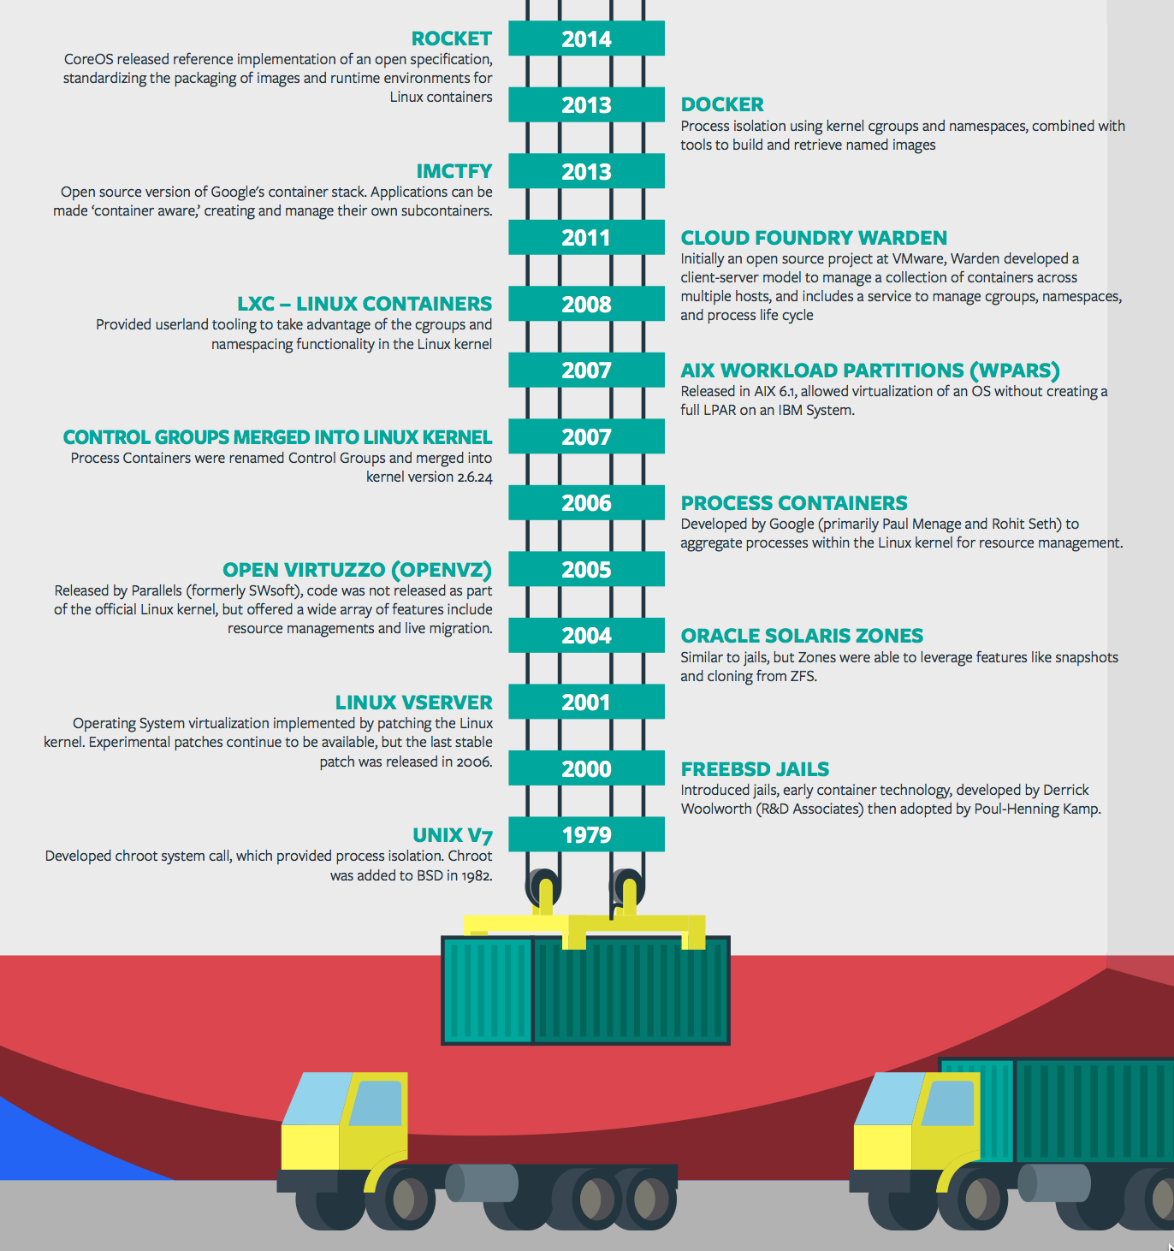
Containers - History
CONTAINERS!!!!
Containers are not new
CF has used containers since it’s inception
CF supports multiple container technologies as first class citizens including Docker, Warden, Garden and runC
Notes:
Linux Cgroups and Namespaces
History of Docker
- 2006 Google to use containers they built cgroups and namespaces and pushed it to the Linux kernel
- cgroups and namespaces give you isolation (Resource Isolation and Namespace isolation)
- dotCloud and LXC fragmentation
- libcontainer created to address application portability and standard API across linux distros BUT controlled by Docker
- Open Container Project (Docker/dockerfile, CoreOS/appc). Standardiized on runC
- Standardizing the file format (dockerfile + appc = filesystem)
- Standardizing the runtime (libcontainer = runC)
- Container (Isolation + Files/metadata + Processes)

Slide 18
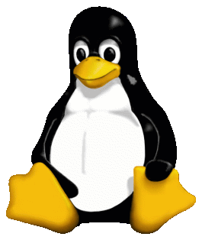
Container Isolation
shared resources
resource isolation
kernel
namespace isolation
Cell
process F
process A
process E
process B
process D
process C
tenant 1
tenant 2
tenant 3
Notes:
----- Meeting Notes (2/10/16 13:49) -----
modify to represent the cell, and change tenants to containers

Slide 19


Container Isolation
CPU
resource isolation
namespace isolation
cgroups
process D
process F
process F
process E
process A
process E
process B
process D
process C
A Linux kernel feature that limits, accounts for, and isolates the resource usage of a collection of processes
tenant 1
tenant 2
tenant 3
Notes:
Cgroups - A Linux kernel feature that limits, accounts for, and isolates the resource usage of a collection of processes
----- Meeting Notes (4/20/16 11:43) -----
Add on to extend a VM?

Slide 20
Container Isolation
PID
2
3
4
2
2
3
resource isolation
namespace isolation
PID namespace
process F
The PID namespace provides isolation for the allocation of process identifiers (PIDs), lists of processes and their details.
process A
process E
process B
process D
process C
tenant 1
tenant 2
tenant 3
Notes:
PID namespace - provides isolation for the allocation of process identifiers (PIDs), lists of processes and their details.

Slide 21
Customize the Container Experience
Buildpacks
Containers
Developer brings customized app
Developer brings customized app
Platform buildpacks provide standard runtime*
Developer brings runtime container image
Platform provides fixed OS container image
Developer brings container OS image
Platform provides fixed host OS Kernel
Platform provides fixed host OS Kernel
App container
* Devs may bring a custom buildpack

Slide 22
Pivotal CF Architecture - Recap
Login Server
OAuth 2.0 Server (UAA)
Blobstore
Ops Manager UI
Cloud Controller
CC Bridge
BBS
Ops Manager Director
Operations Manager
CELL
CELL
etcd
Service Broker
Rep
Exec.
Rep
Exec.
Dynamic Router
Brain
Service Nodes
HA Load Balancer
Garden
.NET
Auctioneer
Service
Converger
Metron Agent
Metron Agent
Service Broker
Access
Loggregator
Service Nodes
Traffic Controller
SSH Proxy
Service
Doppler
Log Firehose
Fileserver
BOSH
Azure

Slide 23
Deploying Cloud Foundry
Overview
Notes:
So how many people in here have heard of BOSH?
BOSH is the cloud foundry platform orchestration engine
This is the same BOSH used in open source cloud foundry, making Pivotal, the closest platform to the original CF!
Then you also know how tedious it can be to manage orchestration via manifest files, hence we created Ops Manager to make an easy way to work with it.
http://bosh.io/docs/about.html
https://bosh.io/docs/bosh-components.html

Slide 24


Deploying the CF Runtime with Cloud Foundry BOSH
BOSH
DB
Worker VMs
Deploy new
CF Instance
BOSH Director
Blobstore
etcd
Message Bus
Deployment
Packages
Blobs
Source
Jobs
Manifest
CELL
Health Monitor
Target VM
Cloud Controller
Target VM
Cloud Foundry Operations Manager/BOSH
Target VM
IaaS

Slide 25
D e m o
Notes:
Show Ops Manager

Slide 26
Pivotal Cloud Foundry
Operations

Slide 27


Pivotal CF operations
Developer
Operator

Slide 28




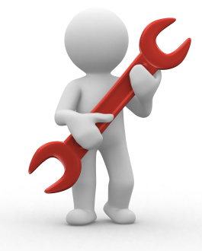





Install runtime and container
Deploy to dev
Install services (db,
messaging, hadoop, …)
Setup load-balancing, SSL termination and dynamic routing
Setup / config
High Availability
App Deployed
Setup APM
Setup log streaming

Slide 29

Blue-green deployment
Restart server
Upgrade app
Deploy to Test
Create service
Deploy to dev
Change JDK
Redeploy
Scale Platform
Scale up
Bind service
Update app
Deploy to QA
Update app server
Unbind service
Change route
Promote to production
Escale memory
Check logs
Scale down
Delete App

Slide 30








The Pivotal CF Way
Deploy to dev
Cloud
Controller
BBS
> cf push
Router
BRAIN
Access
App Deployed
Loggregator

Slide 31


Operators in the Cloud Native Platform Era

Slide 32



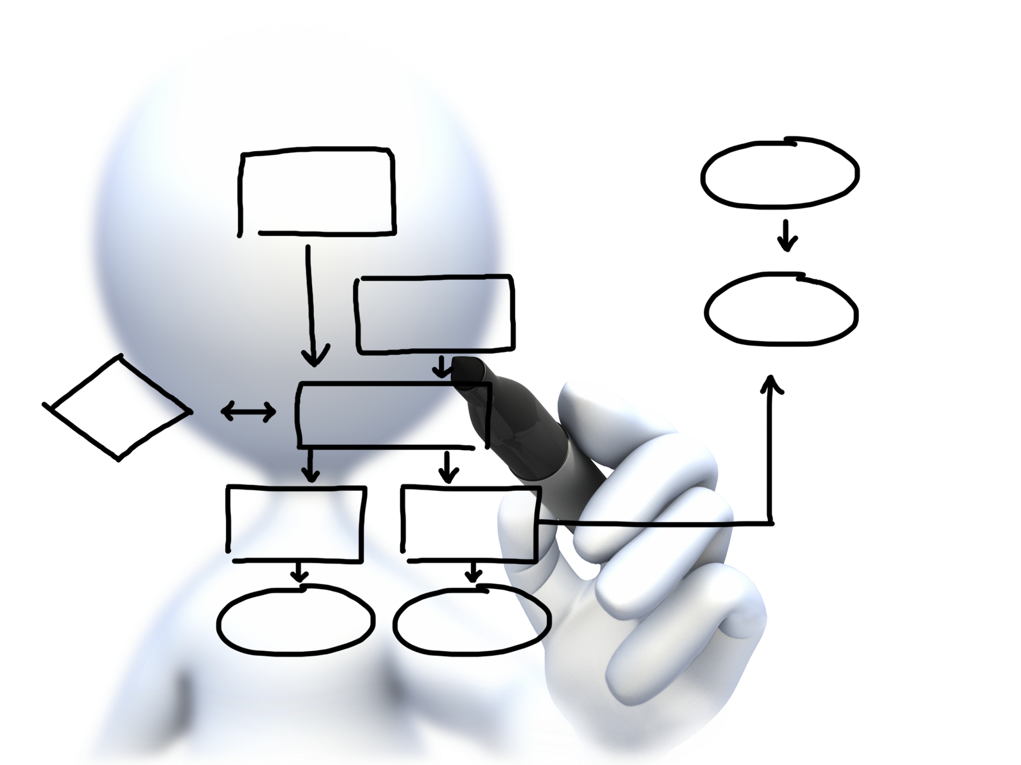


Operator
Concerns
Plan capacity
Setup High Availability
Install the platform
Manage users
and quotas
Handle upgrades and updates
Monitor the platform

Slide 33









Install the platform
Setup High Availability
Pivotal CF
Install and manage services
Target multiple clouds
IaaS
Handle live upgrades and updates
Azure
Scale and
plan capacity

Slide 34


Click to install
No downtime updates
Explore install logs
Pivotal Elastic Runtime
MYSQL for
Pivotal CF
App Autoscaling
Pivotal Ops Metrics
RabbitMQ for
Pivotal CF
Riak CS for
Pivotal CF
Click to scale the platform
Pivotal Redis
Spring Cloud Services
CloudBees Jenkins for Pivotal CF
Built-in High Availability
Cassandra for Pivotal CF
Pivotal HD for Pivotal CF
GitLab for
Pivotal CF
Built-in Platform Monitoring
Elastic Search for Pivotal CF
Mobile Services for Pivotal CF
Spring Cloud
Data Flow
BOSH Director
BOSH Agent
Integrated services
IaaS
Azure

Slide 35
D e m o
Notes:
How to scale the platform

Slide 36
Platform Monitoring
Pivotal Ops Metrics provides a single JMX interface to access metrics for each Pivotal CF component
Cells
Cloud Controllers
Routers
Health Managers
BBS, UAA, Login Server, …

Slide 37
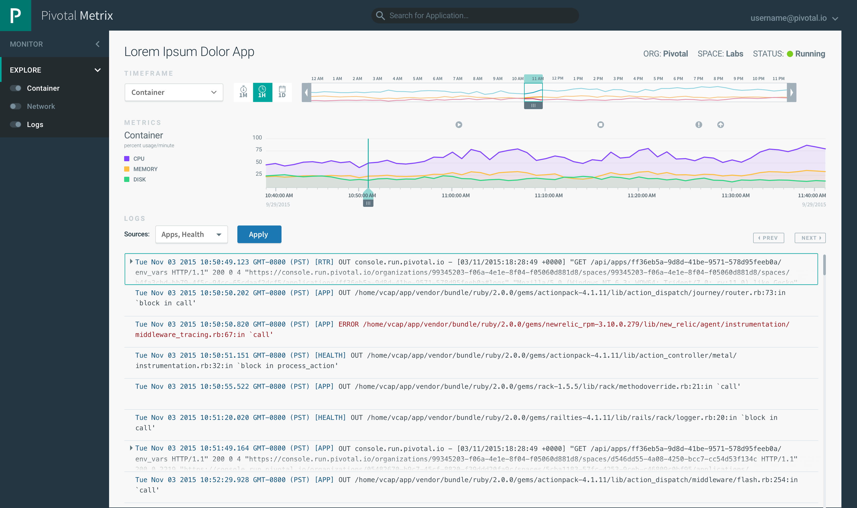
Coming Soon to ERS 1.7
Notes:
This looks a lot like Splunk
Kubernetes doesn’t have built-in logging and analytics capabilities
D

Slide 38
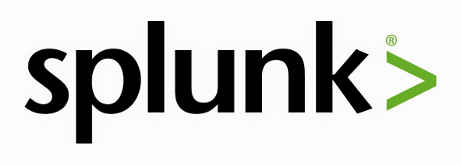
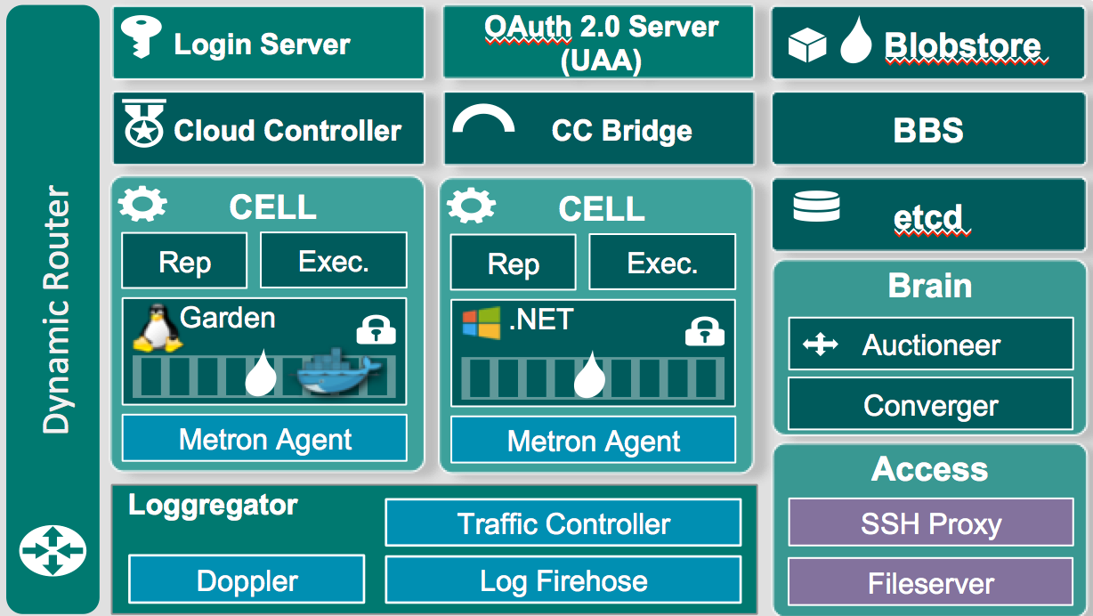
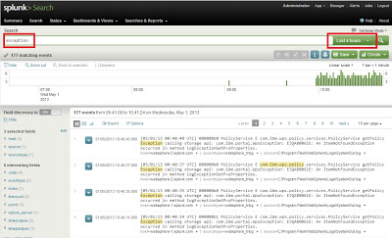
Platform Monitoring
Notes:
Need to install a plugin so Splunk can read CF logs properly
Note this isnt showing a full Splunk Arch

Slide 39
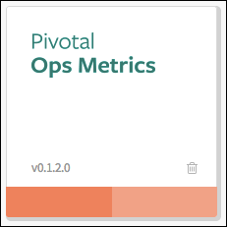
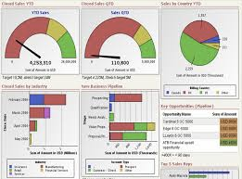
Platform Monitoring
JMX Monitoring Tool
JMX Provider
Collector

Slide 40
Multi-tenancy
Overview

Slide 41
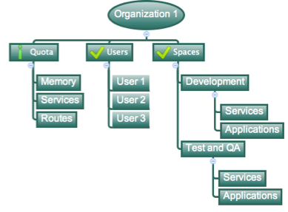
Orgs, Spaces, Users & Quotas

Slide 42
Organizations
Logical division within a Pivotal CF install / Foundation.
Each organization has its own users and assigned quota
User permissions / roles are specified per space within an organization
Sub-divided into Spaces

Slide 43

Quotas & Plans
Different quota limits (e.g. “small”, “enterprise”, “default”, “runaway”) can be assigned per Organization
Quota defines
Total Memory
Total # of Services
Total # of Routes

Slide 44

Spaces
Logical sub-division within an organization
Users authorized at an organization level can have different roles per space
Services and Applications are created / specified per Space
Same Service can have different meanings per space
Spaces can be assigned quotas

Slide 45
Platform Monitoring
How do I know when to scale Cells?
How many requests each Router is servicing?
What is the current load of my Cloud Controllers?

Slide 46
Platform Monitoring
Pivotal Ops Metrics provides a single JMX interface to access metrics for each Pivotal CF component
Cells
Cloud Controllers
Routers
Health Managers
BBS, UAA, Login Server, …

Slide 47
Four Levels of HA
Built In!
Notes:
So how many people in here have heard of BOSH?
BOSH is the cloud foundry platform orchestration engine
This is the same BOSH used in open source cloud foundry, making Pivotal, the closest platform to the original CF!
Then you also know how tedious it can be to manage orchestration via manifest files, hence we created Ops Manager to make an easy way to work with it.
http://bosh.io/docs/about.html
https://bosh.io/docs/bosh-components.html

Slide 48
Four Layers of High Availability – Built In
Application Instance
Platform Processes
Platform VMs
Availability Zones

Slide 49
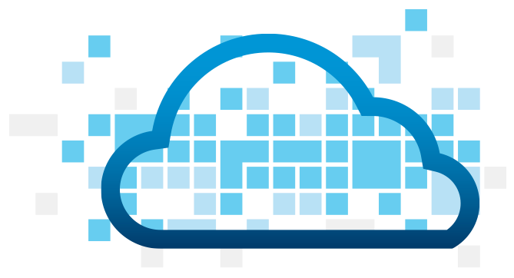
Application Instance HA
Blobstore
Cloud Controller
DB
Service
credentials
creds
Cloud Controller Bridge
Actual State
Desired State
Actual State
Re-deploy App
BBS
Converger & Auctioneer
Router
CELL
CELL
CELL
Exec.
Rep
Exec.
Rep
Exec.
Rep
Runtime

Slide 50
D e m o
Notes:
Kill an App

Slide 51

Platform Process HA
BBS
AGENT
Restart!
Health Monitor
Responses:
Cell
pager
AGENT
pager
Message Bus
email
email
monitoring
monitoring
…
…
Cloud Controller
AGENT
Pivotal CF Operations Manager
IaaS
Notes:
Two processed on the VMs are MONIT and BOSH agent
Monit monitors the actual state of processes, while BOSH agent is used to communicate the status to the health monitor
In a process goes down, Monit tries to restart it
If successful, or not, BOSH agent is notified, who then tell Health monitor, which will notify the operator
The processes running on the virtual machines (i.e. the health manager) are started with monit, an opensource linux utility that keeps an eye on processes and will respond when one dies. If a process dies then, monit will do two things: first, it will try to restart the process and second, whether the restart is successful or not, it will tell the BOSH agent about the failure. Recall that the Bosh agent is there to communicate with Operations Manager and in this case it will relay this failure information to the Operations Manager Health Monitor (not to be confused with the Health Manager of the elastic runtime that was discussed above) – we’ll abbreviate it OMHM. The OMHM will take this alert and pass it through a list of responders that can be configured to do things like send emails, page administrators and display alerts in operations dashboards. There’s a good chance that monit will already have recovered the process, but we also want there to be an opportunity for a human to respond.

Slide 52

Platform Virtual Machine HA
Cloud Controller
DB
Agent
Process
BOSH Director
Health Manager
Blobstore
Agent
Process
Re-create VM
Ressurector
BBS
VM is
missing…
Agent
Process
Message Bus
Health
Monitor
Cloud Controller
Agent
Process
Pivotal CF Operations Manager
IaaS

Slide 53
Availability Zone HA
Zone 1
Zone 2
Availability Zones are vCenter Resource Pools
Cell
Cell
System components and Application instances are evenly distributed over two availability zones.
Cell
Cell
Router
Loosing an AZ keeps instances running and available.
Cell
Cell
Runtime
Notes:
Zone could = rack, for example

Slide 54
How Pivotal Enables Four Levels of HA
1.
2.
3.
4.
PCF
PCF
PCF
Zone 1
Zone 2
A
B
C
A
B
C
A
B
C
A
B
C
A
B
C
A
B
C
A
B
C
Process
VM1
VM2
VM3
B
B
B
B
3. Resurrector restarts failed VMs
VM1
VM2
B
A
B
C
A
B
C
A
B
C
A
B
C
OS,
Mware
OS,
Mware
OS,
Mware
B
B
B
B
If an app fails, PCF reboots app in a new container.
If a process fails, PCF restarts the process
If an OS or network failure occurs PCF kills the VM and reboots the host in a new Virtual machine.
If a datacenter rack fails, PCF ensures applications stay running in multiple availability zones
App Fail
Process Fail
VM Fail
Rack Fail
Notes:
Application performance and reliability have a direct correlation to HA capability. Pivotal provides 4 level of HA so that you don’t need to invest in people/software to handle common failure situations. If an application fails, we will reboot it in a new container. This automated remediation addresses application bugs that result in outages. If a Pivotal process fails, we will reboot it in a new virtual machine. Our PaaS essentially monitors and remediates itself. If an OS or network failure occurs, our VM monitor will detect this and kill the VM, then reboot it in a new container. This streamlines Linux sysadmin operations. Lastly, if a datacenter rack fails, we will ensure the application stays running because we load application instances in multiple availability zones. No 2 availability zones live on the same datacenter rack. This hardware failure level resilience is very difficult to design using traditional tools provided by HP/CA/IBM.
And, by using Pivotal, you reduce the number of servers that require HP/CA/IBM monitoring tools.
http://blog.pivotal.io/cloud-foundry-pivotal/products/the-four-levels-of-ha-in-pivotal-cf
Desired State of Application is maintained by Cloud Controller. DEAs communicate status of their apps to Health Manager. HM checks with CC. CC restarts app in another DEA in case of failure
PCF Processes monitored by monit and restarted in case of failure
In case of VM failure. Health Monitor is notified. HM calls BOSH Director which calls Resurrector component which starts up the VM (with processes)
Availability Zones is a logical grouping of the deployment of System Components and DEAs. (Example would be two racks in a datacenter)

Slide 55

Operator
Concerns
Plan capacity
Setup High Availability
Install the platform
Manage users
and quotas
Handle upgrades and updates
Monitor the platform

Slide 56
D e m o
Notes:
Org and Space Tour with Quotas

Slide 57



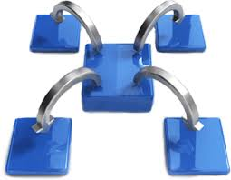
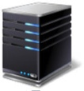

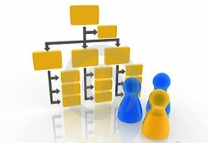





Capabilities of Pivotal Cloud Foundry
Automatic App Server & OS Configuration with Buildpacks (“just push your app”)
Application
Containerization & Cluster Scheduling
Application Network Security Groups
Application to Services Binding and Access
App Health,
Load Balancing,
Rapid Scaling, Availability Zones
Policy, Identity and Roles Management
Logging as a service,
Application metrics & performance,
Metric based scaling
Native & Extended Data, Mobile and Platform Services
IaaS Provisioning, Scaling & Configuration
Deploy, Operate, Update & Scale with minimal downtime on choice of IaaS
Azure
Notes:
Key Platform Capabilities
On Demand Scaling
Application Health Management
Dynamic Routing & Load Balancing
Log and Metric Aggregation
Security
WHAT
Pivotal CF is next generation middleware that delivers 9 things that are typically delivered via point software products.
We provision operating systems and middleware.
We deliver workload density without compromising application performance.
We ensure that applications have appropriate network security safe guards to prevent security threats.
We support application connections to external sources including databases and legacy middleware.
We provide 4 levels of HA, with built in load balancing for scale in/out
We support multi-tenant environments so that each line of business can operate with a discrete quota and isolated system access.
We provision next generation data services including NOSQL databases, traditional databases and hadoop clusters.
We provide horizontal and vertical scaling for the underlying IaaS so that you can scale your infrastructure in lock step with your Business.
We provide a built-in log aggregation service, built-in APM metrics and utilization based auto-scaling so that you can monitor the health of your applications and scale out without human or 3rd party tool intervention.
I am going to cover each of these 9 capabilities in more detail, but it’s important to note the impact of this collection of capabilities. The following slides will include information on CAPEX and OPEX reduction. We will also discuss how you can deliver faster time to value while holding the line on infrastructure cost.

